Slide 1
MIAAA Fall Conference Presentation
Presenters: Michael Archer & Cameron Archer

Slide 2
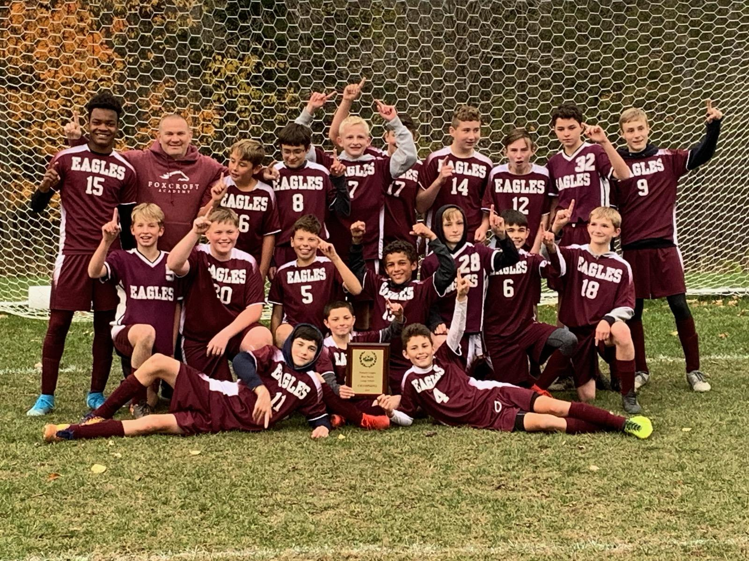
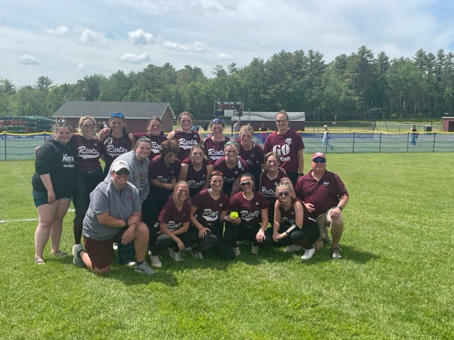
The Transition from Middle School Athletics to High School Athletics

Slide 3
Talking Points:
MS vs HS Philosophies
Skills vs Systems
Fostering Growth & Development
Mentoring/Leadership Opportunities
Feeder Programs
Student-Athlete Expectations
Academic Transition
Quality Coaching/Educators
Communication
Transition Tools/Essential Practices/Knowledge of Resources

Slide 4
Overriding Question for this Session:
What are the challenges that we see when a student-athlete transitions from middle school athletics up to high school athletics?

Slide 5
Middle School Philosophy
-Athletic programs are designed to meet the developmental needs of student-athletes through exploration of various sports.
-Middle School athletics should focus on fundamental skills, teamwork, sportsmanship and introducing basic strategy.
-Coaches should help student-athletes develop an understanding and appreciation for the difference between a win and a loss, but remember that winning is not the biggest priority.
-Make it fun, enjoyable, and valuable to their love for the game.

Slide 6
High School Philosophy
Every school should have this as part of their athletic handbook and it should be at the forefront.
Philosophy may include:
-The purpose of co-curricular activities
-Ideals of sportsmanship
-Stressing personal and team development
-Helping students reach their fullest potential through sport
-Where is the focus placed on winning at the high school level?

Slide 7
Skills vs Systems: Middle School Athletics
Middle School Athletics should:
-Focus should be primarily on skill acquisition and development
-Introduction of age appropriate functional strength and conditioning
-Meaningful, but NOT equal playing time
-Fundamentals and technique to ease the transition
-Winning should not be the primary focus

Slide 8
Skills vs Systems: High School Athletics
High School Athletics should:
-Fundamentals and Skills continue but systems are now being taught
-Develop an understanding of strategy and mental preparation
-Overall commitment increases at each level (Frosh/JV/Varsity) which may include off season
-Differentiate between player role and player value
-Stress the importance and increase of academic rigors (Time management)

Slide 9
Fostering Growth and Development
-Introducing level appropriate strength and conditioning exercises/programs
-Introducing level appropriate cognitive concepts
-Acknowledging difference of age, size, and development of a student-athlete
-Putting the athlete in the best possible position to succeed and grow both in the short term, and long term.
-Continue to develop an appreciation for the game and how various aspects of athletics compliment the qualities we teach in everyday life.

Slide 10
Mentoring and Leadership Opportunities
What opportunities can we provide for high school student-athletes to work with our middle school athletes?
• Proximity of buildings on campus?
• Clinics
• Buddy program
• Coaching opportunities in the youth programs
• Allowing a MS game day to be played at the HS facility

Slide 11
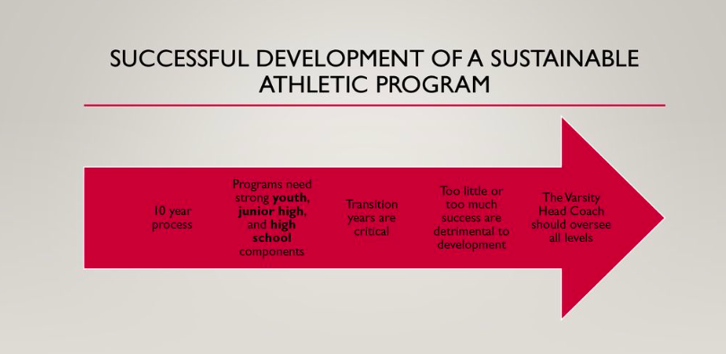
GROUP DISCUSSION QUESTION:
Are your middle school athletic programs a feeder system to your high school programs? If so, provide examples of what that looks like.

Slide 12
Student-Athlete Expectations
-In the term student-athlete, note what comes first.
-Commitment, Time, Organization
-Team Chemistry
-Engage in summer programs during summer of 8th-9th grade transition year
-Communicate to parents the levels of commitment

Slide 13
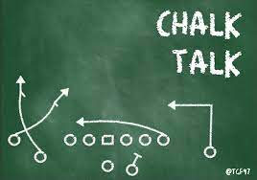
Quality Coaches/Educators
-Ability to build relationships and strong rapport with student-athletes
-Even at the middle school level, coaches are hired by a committee and go through a series of interviews.
-Must have the ability to TEACH fundamentals and strategic concepts.
-MAKE IT FUN!!

Slide 14

Communication
High School AD & Middle School AD Relationship?
Sharing Facilities
MS Coaches and JV/Varsity Coaches communicate with one another. (Is it a program?)
School Choice Dynamics
Common terminology is used at both levels.
Athletes understand the expectations and goals for the program.

Slide 15
Questions?
Comments?
THANK YOU!

