Slide 1
The Transportation Dilemma
Jason Fuller & Evan Graves
Notes:
Introductions.
*NOTE:Caribou Bussing isn’t so much of an issue. We have some LONG trips and long days for our bus drivers. We do have a small rotation of drivers who are willing to do the trips. They have pride in what they do. They get good overtime and although there has been situations where it’s been tight to have a driver, we’ve always made it work. I’ve had to get creative with scheduling to not have too many trips in a given day. We are fortunate to drivers who take pride in what they do. Last year I spoke with coaches about getting their bus drivers license and I did have one coach who got his license and it was a great asset for the school.

Slide 2

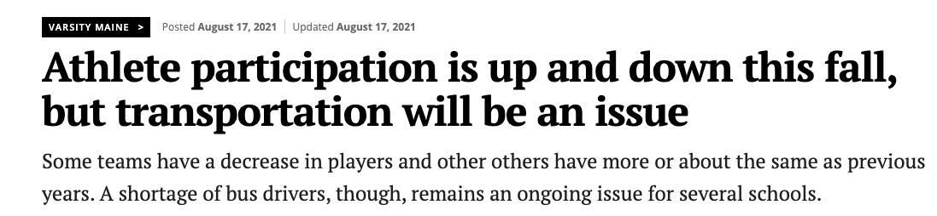
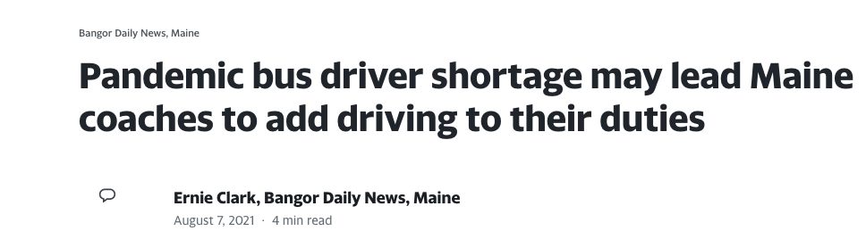

Slide 3
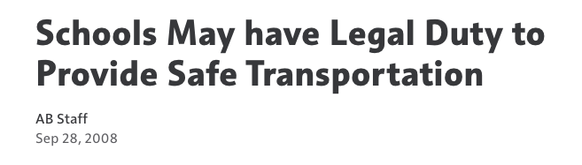

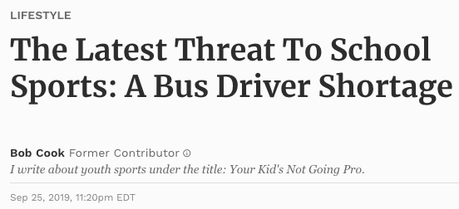
Notes:
It is our duty to provide safe transportation for our athletes. How can we still do that with less drivers and more events than 14 years ago when this article was written? Some schools are dealing with having to push games back, cancelling JV contest, or canceling games period.

Slide 4
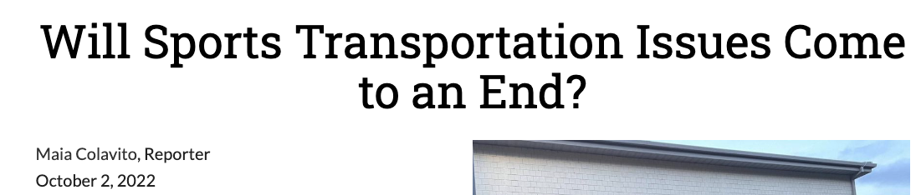
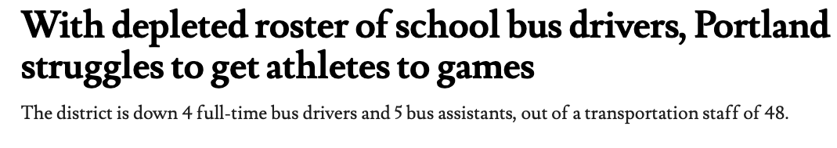
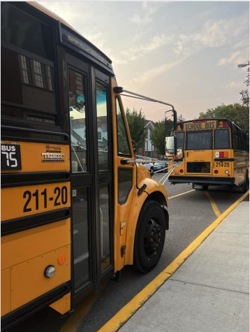


Notes:
https://nhschiefadvocate.org/2022/10/will-sports-transportation-issues-come-to-an-end/
https://madison.com/news/local/education/local_schools/parents-coaches-lament-lack-of-co-curricular-transportation-in-madison-as-equity-issue/article_9c84ff20-317b-526a-914b-e9a8cb857990.html

Slide 5
WHY are we having this dilemma?
More bus drivers retiring
Low wages
Trips are long and take away from family time
Lack of qualified people to drive
Candidates not able to pass a drug test
Training; quality, availability, and cost
Hiring and retaining
Part time staff don’t receive benefits
More extracurricular activities in our schools
Notes:
For CHS…We have a few who want the trips (3 person rotation) they get GOOD overtime. They have pride in what they do. Showing up to an event with our school/community on a bus says a lot about who we are. The bus is clean and people recognize that.

Slide 6
Requirements to Drive a Bus
CDL License
With a
Passenger (P) Endorsement
&
School Bus (S) Endorsement

Slide 7
Steps to Get Certified to Drive a Bus
Get your permits (CDL with P & S Endorsements) through 3 written tests at the DMV (there is a study book for this test)
  Must have a valid license to sit for your CDL permit test (minimum of 1 year) & 21 yrs old
Pass a background check, fingerprinting, DOT Physical & Drug Test
  Presence of marijuana results in a 1 year suspension
On the road training (40-60 hrs) under the supervision of a certified trainer
  Certified trainer has to be an individual that has completed a state course
Pass your road test with the BMV, DOT & State Police
  Presently, there is an 8-10 week waiting period for the road test
  Road test does include a bus pre-trip test
Complete any additional local training
These steps can vary depending on hiring company

Slide 8
Maine DOE: Report on issues related to school transportation
January 2020 report review, themes from the discussion:
Training: Availability of free permit class through adult ed, fee’s are a barrier for some.
Hiring and retaining: need to promote and elevate the career area. Seek non traditional drivers.
Other pressures: Scheduling of afterschool and athletic events, increase in needs for special transportation.

Slide 9
Solutions…The reality
Higher pay for bus drivers, additional roles for overtime pay.
Recruit coaches to get their bus drivers license
Recruit retired bus drivers
Talk to local individuals who already have a CDL (Firefighters)
Recruit retired military
Use a van or other school vehicle when applicable/needed
Parents transport students to events (NOT ideal, but an option)
Creating schedules. I.e Play day for JV level

Slide 10
More of the reality
Socioeconomics:
Be aware of the situations in your community, not all parents have the ability to transport their children.
Parents work schedule
Lack of a vehicle
Single parent families
Multiple students involved in extracurricular activities

Slide 11
Reimaging
How can we rethink scheduling? When applicable, have a middle school event with a high school event…NOT ideal for putting older kids on the bus with younger kids, but could mean a few extra games especially at the ML
How do we rethink some events…i.e a play day when applicable for the JV level, multiple games in one day.
Bigger XC meets, nordic, alpine, wrestling tournament on a Saturday, LONG day, but less events during the week.
Focus on Regional schedules
Tying schedules together. I.e playing the same school in multiple sports at the Varsity level at the same time, soccer and field hockey.

Slide 12
Reimaging continued…
Share transportation with other schools or share drivers with other schools…we have numerous trips with a few trip drivers…We have had our drivers drive for other school districts when they’re in a pinch.
Conversation has been had to share a bus between 2 districts for events like Cross Country running, nordic skiing, Alpine skiing. *understand its not ideal, but some communities are doing it.
Mini bus that a coach could drive
Students have parents drive them to events (not ideal, but a potential option when contests are close).
Notes:
https://framinghamsource.com/index.php/2022/10/03/2022-swim-framingham-high-athletic-teams-struggling-with-transportation-issues/
https://fhcsportsreport.com/15410/features/busing-shortages-cause-transportation-issues-for-athletes/

Slide 13
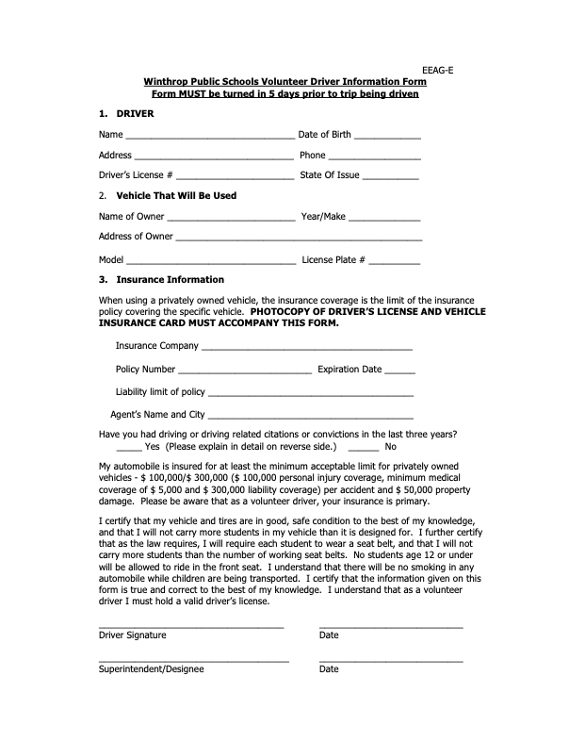

Slide 14
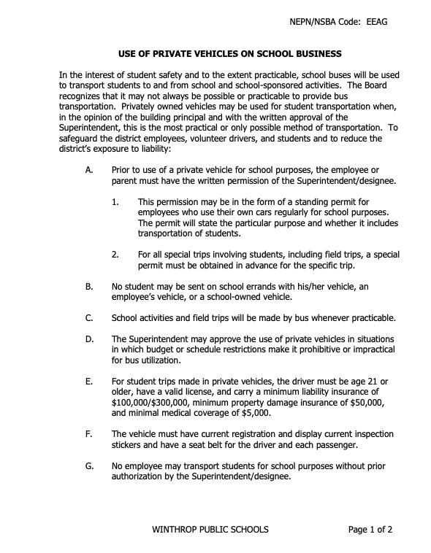
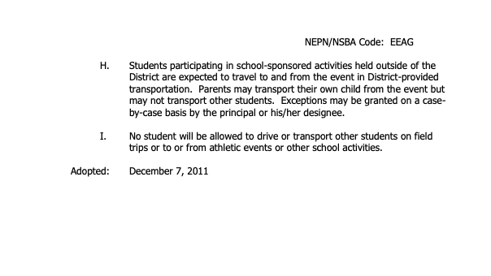

Slide 15
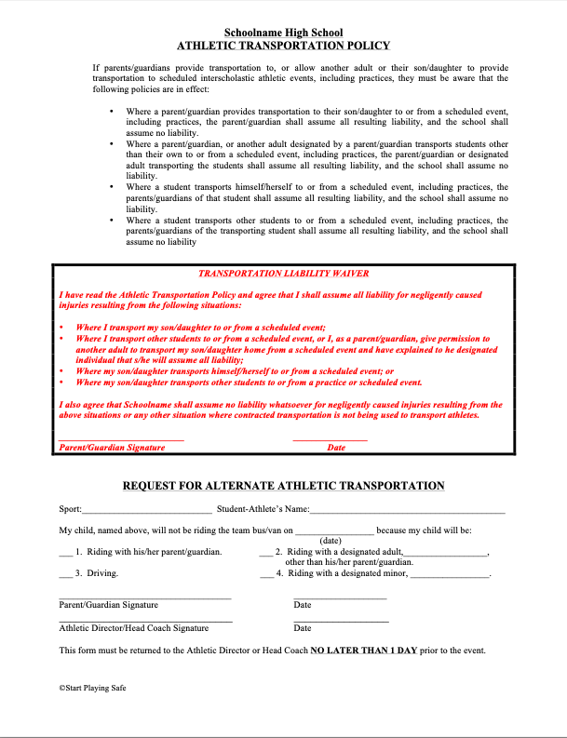
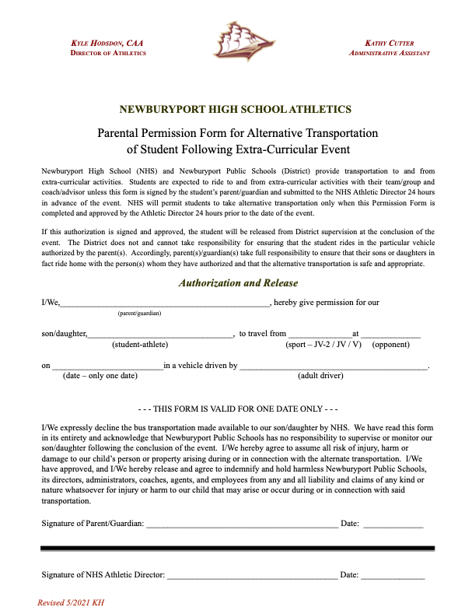

Slide 16
Regulations around minivans/minibuses
Regulations & Requirements Can Be Different Based on Who you Ask
DOE, BMV, State Police & State Law can have different requirements & understanding of the laws
KEY: Based on manufacturing specifications (can’t alter these specifications)

Slide 17
Confusion in the Regulations
*Per federal & state regulations: NHTSA’s statute defines a “school bus” as any vehicle that is designed for carrying a driver & MORE than 10 passengers and which, NHTSA decides, is likely to be “used significantly” to transport students to or from school or related events
“School Bus” means CDL with a P & S endorsement
Best Practice Listed on Maine Department of Education:
National Congress on School Transportation. "To assure the highest level of safety for children, consistent with the NTSB’s [National Transportation Safety Board] recommendation and 45 CFR 1310, all students transported to and from public and private pre-school programs and school and to related activities shall be transported in school buses as defined in Title 49, CFR Part 571 or in vehicles having passenger crash protection equivalent to school buses, such as multifunction school activity buses (MFSABs)."
Source: National School Transportation Specifications & Procedures, page 126.
Fed. Regulations state that schools can not purchase or lease 15-passenger vans
Exception: NHTSA does not regulate a school’s use of a bus to transport children. Each state has the authority to set its own standards

Slide 18
Confusion in the Regulations
*State Statute (Title 29-A): Provision for a “Multifunction school activity bus”
Defined as Noncommercial motor vehicle designed to carry 15 or fewer passengers including the driver
Noncommerical means no need for CDL license
Does have Specifications what the bus looks like - no traffic control requirements
Can not be used to transport to individual homes or bus stops
Need a CDL to operate a vehicle that accommodates 15 or more passengers
Based on Manufacturing Specifications
Private Schools have different requirements as long as it’s operated w/ public funds

Slide 19
Special Endorsement
On the CDL State Application through the BMV:
3 Endorsement (Cost is $20.00)
SCHOOL BUS: designed to carry 15 passengers or less including the driver. Commercial driver’s license not required. Must be 21 and skill & road test required

Slide 20
Adding to your workforce
Having someone to train bus drivers
Offering referral bonuses
Offering sign-on bonuses
School districts have a pay to learn programs, districts cover the fee
Regional tech programs offering CDL to students, this is our future drivers
Adult Ed. in conjunction with tech programs offer course for adults
Signs up at the school and announcements at games to help recruit

Slide 21
In Closing
What is your district doing to help curb this problem?

