Slide 1

The Twenty-First Century Athletic Administrator: Being an
Effective Communicator
2023 MIAAA Fall conference
Monday, November 6, 2023

Slide 2

5 QUALITIES ATHLETIC DIRECTORS SHOULD POSSESS
Excellent Analytical and Budgeting Capabilities
Outstanding Communication Skills
Interpersonal Leadership Abilities
Organizational Abilities
Commitment To A Healthy Lifestyle
https://www.sports-management-degrees.com/

Slide 3
Communication 101 FOR THE ATHLETIC DIRECTOR
Be clear and concise
Plan, prepare, & practice
Use tact and discretion whenever possible
Understand the nature of perceptions
Consider the tone of your presentation
Cover all major points

Slide 4
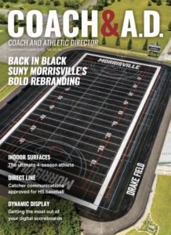
Communication 101 FOR THE ATHLETIC DIRECTOR
Do not make assumptions
Be aware of your timing
Have all the facts
Use humor if applicable
Understand/anticipate a disagreement
Dr. David Hoch; Coach & AD; September 16, 2014

Slide 5
It all comes down to….
Being organized
Finding your own system
Knowing your audience
Finding out how best to reach your audience…Social Media
Best practices: documentation, decisive & to the point; not long winded

Slide 6
By request
Email Overload: How To Manage it in 2023

Slide 7
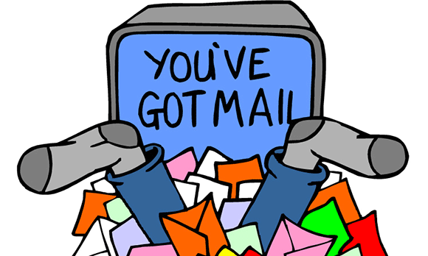
Do you have Email Overload?
Missing important information…deadlines, changes…..
Inbox if filled with follow up emails on unanswered emails…
“Losing” unread emails….
“Sunday panics”…trying to “catch up on emails”
Coaches, parents, administration…notice the reply is not timely

Slide 8
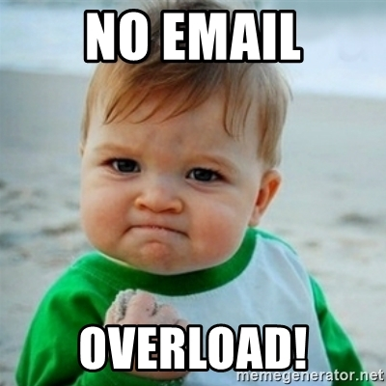
How to manage and prevent email overload
Use tags to keep inbox organized – Filter by topic, sender,….
Send clear and concise emails to prevent follow mail
Avoid using “Reply All” unless necessary
Separate work and personal email addresses
Check email only at certain times to avoid distractions
Develop other communication channels...IM

Slide 9

How to manage and prevent email overload
Set up vacation responder
Unsubscribe from unsolicited email
Remember:
*More emails = Less productivity
*Lost conversations & tasks
*Email is 24/7…need to get away from it
https://www.rightinbox.com/blog/email-overload#Email_Overload_is_a_Cry_for_Help

Slide 10
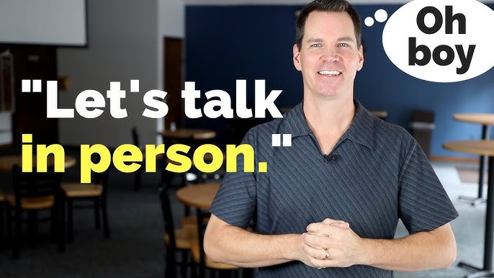
Maybe even…..

Slide 11
Your Thoughts
What are some communication strategies you have found worked well?
How do you manage email?

